Slide 1


Green Pace
Security Policy Presentation
Developer: Andrew Riley

Slide 2

OVERVIEW: DEFENSE IN DEPTH
The graphic below provides an overview of the Defense in Depth method

Slide 3
THREATS MATRIX
Likely Threats that are common/likely to happen | Priority Standard that is highly relevant
Low priority Standard with low relevance | Unlikely Threats that are uncommon/unlikely to happen

Slide 4
10 PRINCIPLES
Validate Input Data
Heed Compiler Warnings
Architect and Design for Security Policies
Keep it Simple
Default Deny
Adhere to the Principle of Least Privilege
Sanitize Data Sent to Other Systems
Practice Defense in Depth
Use Effective Quality Assurance Techniques
Adopt a Secure Coding Standard

Slide 5
CODING STANDARDS
Include the appropriate type information in function declarations.
Use only explicitly signed or unsigned char type for numeric values.
Do not inadvertently truncate a string.
Sanitize data passed to complex subsystems.
Do not access freed memory.
Use a static assertion to test the value of a constant expression.
Handle all exceptions.
Never hard code sensitive information.
Close files when they are no longer needed.
Do not declare more than one variable per declaration.

Slide 6
ENCRYPTION POLICIES
Encryption at rest: Encryption at rest aims to prevent unauthorized access to data on the disk. Encrypting this data adds an additional layer of security, as even if the data is accessed, it will be unusable without the encryption key.
Encryption at flight: Encryption in flight is the practice of encrypting data while it is being transmitted. This ensures that if the data is intercepted during transmission, it is unusable by the attacker.
Encryption in use: Encryption in use is the practice of encrypting data while it is being used. If an attacker were to gain access to unencrypted data in use, that data could be used to enable access to both data at rest and data in flight.

Slide 7
TRIPLE-A POLICIES
Authentication: Authentication is the practice of confirming a user’s access to a network or system, usually via a user login. Newer, more advanced systems require two factor authentication, such as a user login combined with biometrics or a single use access code.
Authorization: Authorization refers to the specific level of access granted to a user. This includes privileges to make changes to the database, such as write or delete data, as well as add users. Most users will simply be able to read the information on the database, while the ability to make changes will be limited to a select few people.
Accounting: Accounting is the process of monitoring user activity. This aids in identifying unauthorized access to the system. User activity is monitored to ensure that they are only accessing information that they are authorized to access.

Slide 8
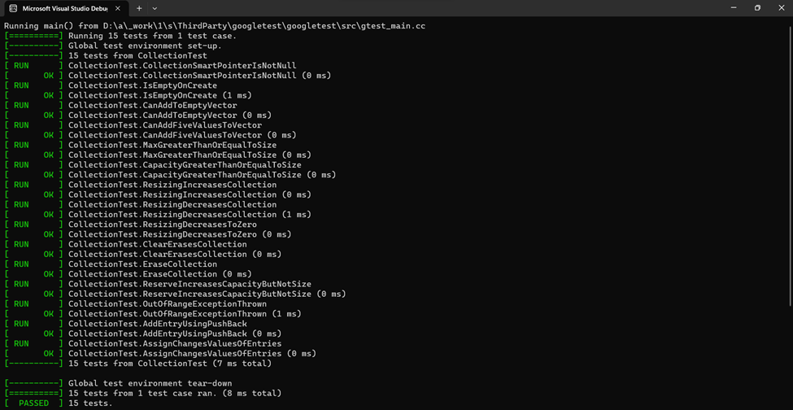
Unit Testing
Unit testing helps to identify and correct vulnerabilities in the code. Testing early in often in the development process is the best way to utilize these unit tests. For example, testing for buffer overflow caused by invalid user input can prevent this vulnerability from being exposed.

Slide 9

AUTOMATION SUMMARY

Slide 10
TOOLS
The DevSecOps pipeline is a secure coding method that has a full circle approach to enforcing a policy that has an infrastructure built on efficiently keeping code secure.
Parasoft C/C++ test: Fully integrated software testing solution.
Astrée: A static code analyzer that proves the absence of runtime errors and invalid concurrent behavior.

Slide 11
RISKS AND BENEFITS
When writing code, it is best to consider all threats and test for vulnerabilities early and often. Waiting to test can result in more time and resources necessary to fix the problem, as a vulnerability created early on can now be affecting multiple subsystems.
It is also important to stay up-to-date on current threats. Threats and bad actors change frequently, and therefore it is important to use current information to check code for relevant vulnerabilities.

Slide 12
RECOMMENDATIONS
Always assume code will be subjected to malicious attacks and plan accordingly.
Stay up to date on current threats and bad actors.
Incorporate defense in depth and triple A into all code.
Test early and often.
Use secure coding best practices.

Slide 13
CONCLUSIONS
In conclusion, the creation of security policies and the implementation of secure coding best practices can drastically help to prevent vulnerabilities in code from being exploited. Utilizing defense in depth, triple A, and early/frequent testing methods are the best ways to ensure that the code is secure.

Slide 14
REFERENCES
Seacord, R. C. (2013). Secure Coding in C and C++ (2nd ed.). Pearson Technology Group. https://mbsdirect.vitalsource.com/books/9780132981972

